Slide 1
Service Mesh & Security
For Kubernetes
Version 1.0

Slide 2
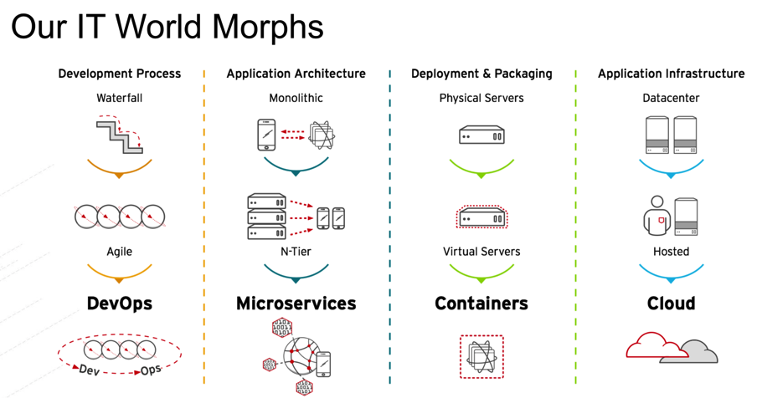
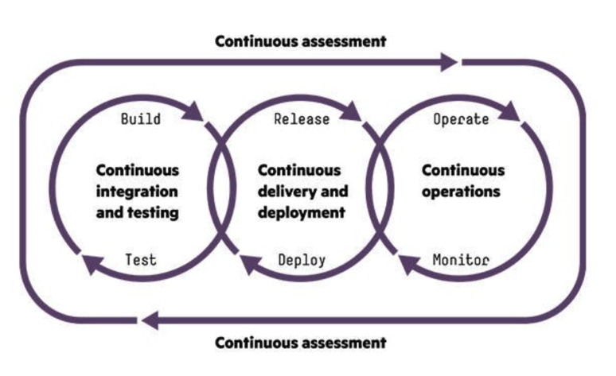
1. Digital Transformation: IT World is changing
https://www.slideshare.net/asotobu/sail-in-the-cloud

Slide 3
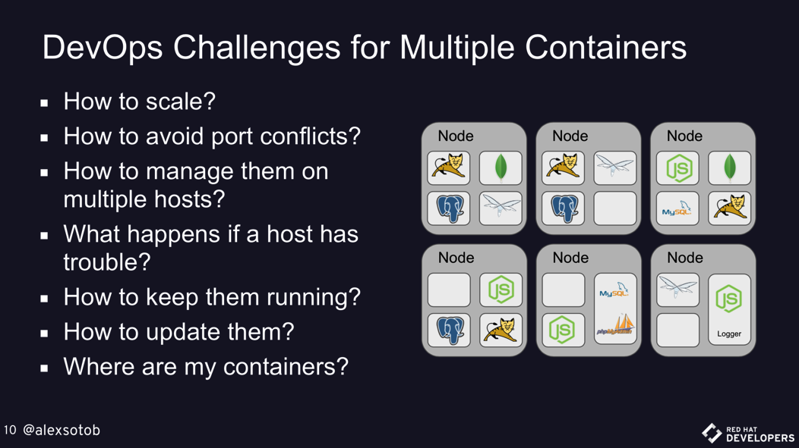
1. Digital Transformation: New challenges
https://www.slideshare.net/asotobu/sail-in-the-cloud

Slide 4
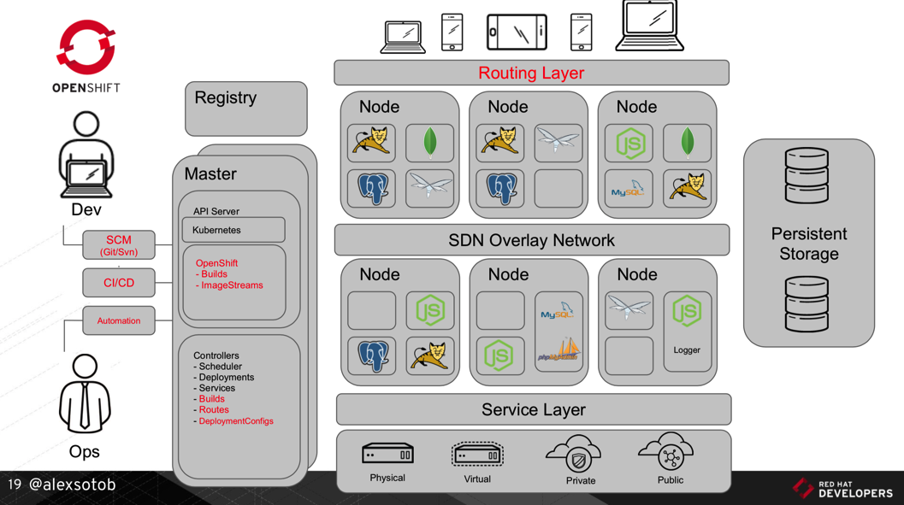
1. Digital Transformation: A new Platform
https://www.slideshare.net/asotobu/sail-in-the-cloud

Slide 5
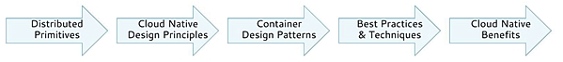
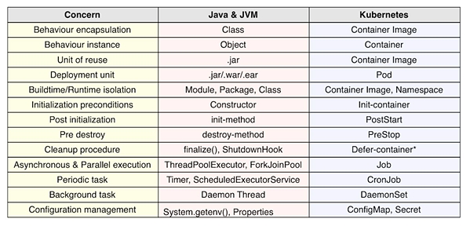
2. Kubernetes effect on the SDLC: Primitives (1/2)
1
https://www.infoq.com/articles/kubernetes-effect

Slide 6
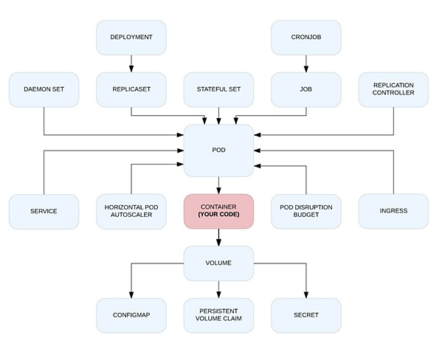
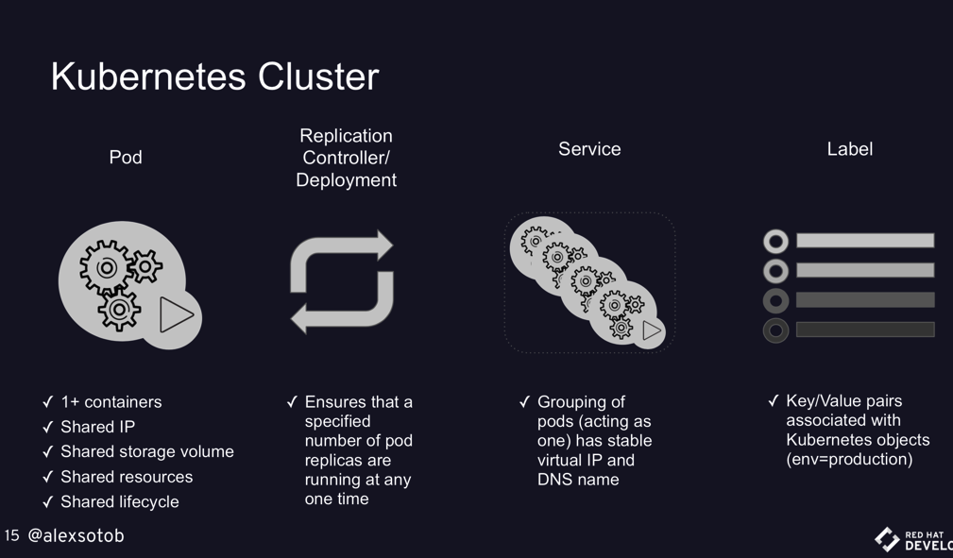
2. Kubernetes effect on the SDLC: Primitives (2/2)
1
https://www.infoq.com/articles/kubernetes-effect
https://www.slideshare.net/asotobu/sail-in-the-cloud

Slide 7
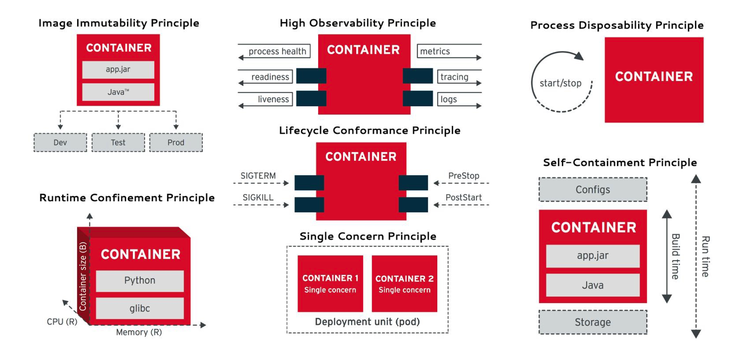
2. Kubernetes effect on the SDLC: Principles
2
https://www.infoq.com/articles/kubernetes-effect

Slide 8
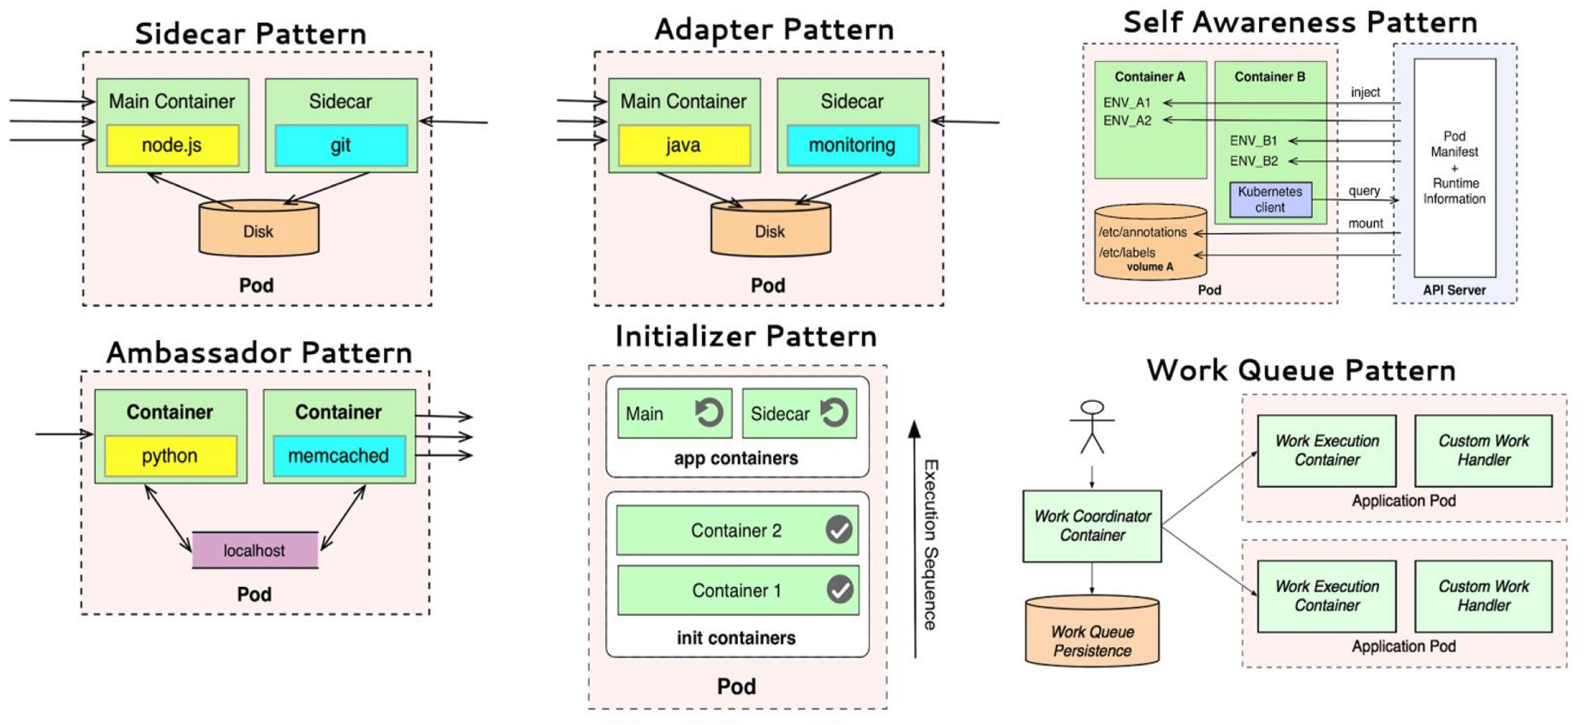
2. Kubernetes effect on the SDLC: Patterns
3
https://www.infoq.com/articles/kubernetes-effect

Slide 9
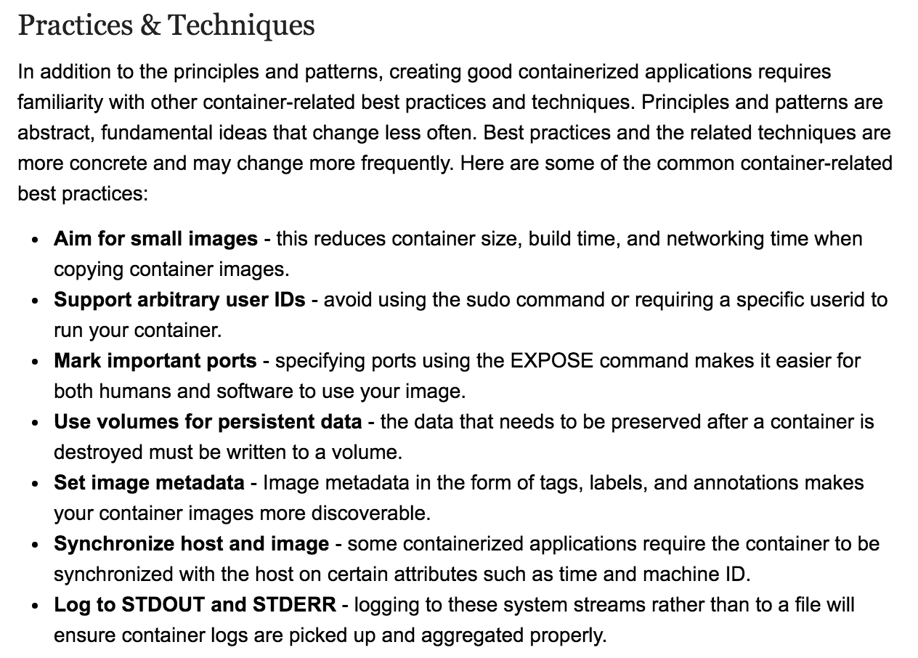
2. Kubernetes effect on the SDLC: Best Practices
4
https://www.infoq.com/articles/kubernetes-effect

Slide 10
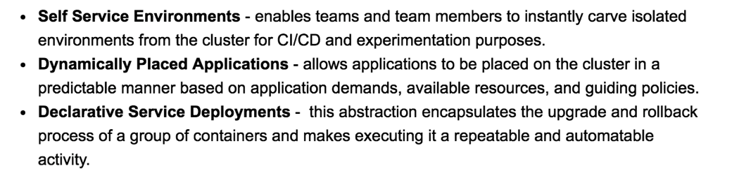
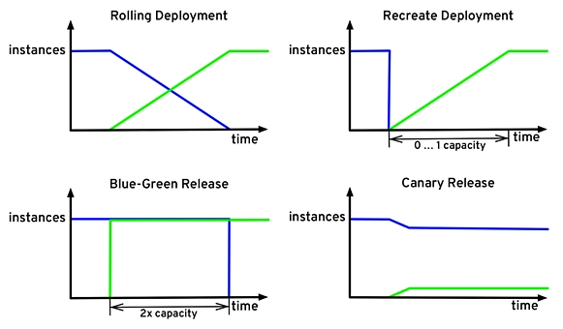
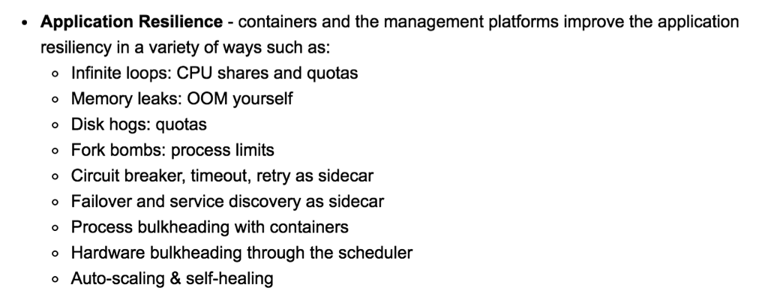
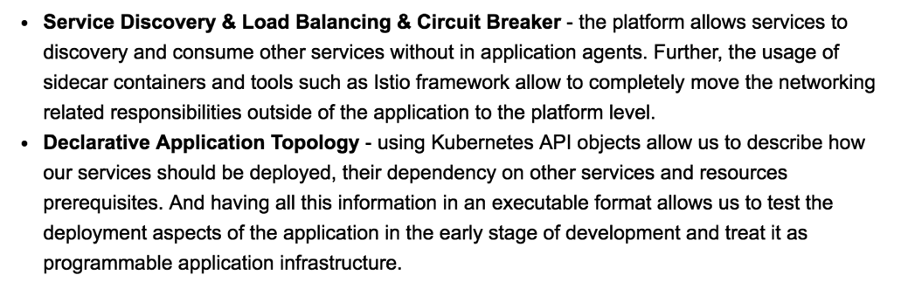
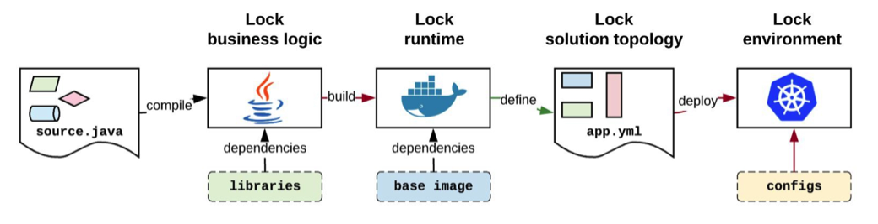
2. Kubernetes effect on the SDLC: Benefits
5
https://www.infoq.com/articles/kubernetes-effect

Slide 11


3. Building your K8s platform
Vanilla
Kubernetes Clients
Kubernetes flavours
Self Managed
Full Managed Cloud
kubectl
(kubernetes)
Kubernetes Cluster
On-premise
Google Kubernetes Engine
Lab 00: Building K8s
KVM
VMWare
oc (openshift)
RedHat OpenShift v3
Azure Container Service (AKS)
Amazon EC2
az
(azure)
RedHat OpenShift Container Platform
Minimalist
Minikube
OpenShift
Minishift
Amazon Fargate
Amazon EKS
Amazon ECS
Managed

Slide 12
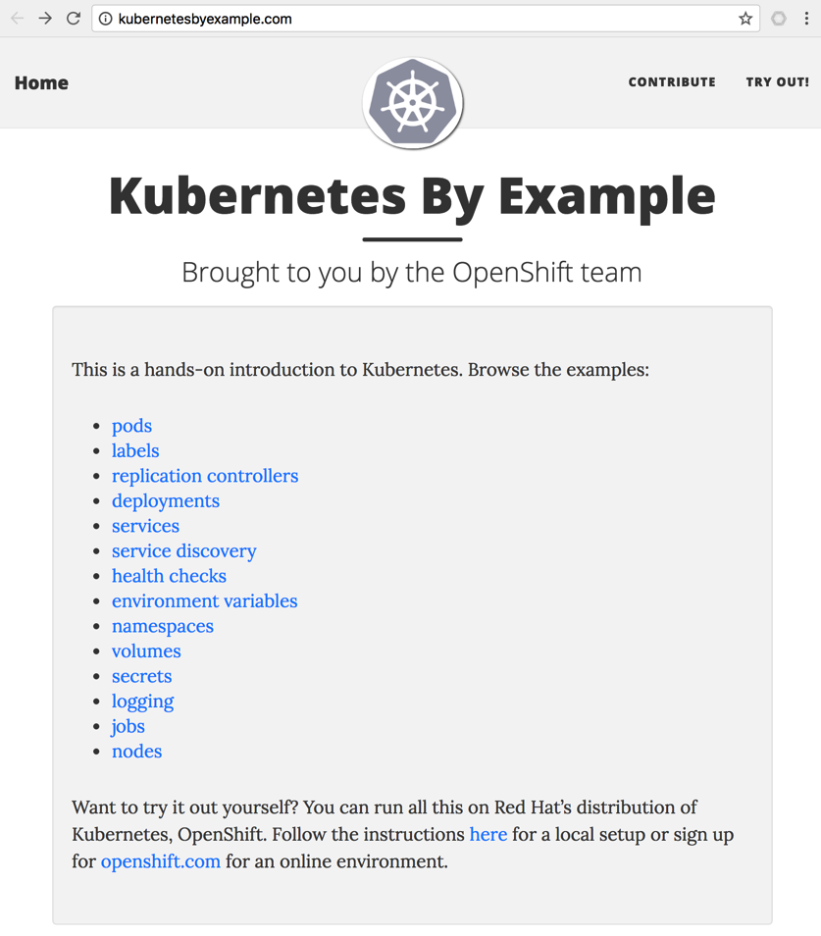
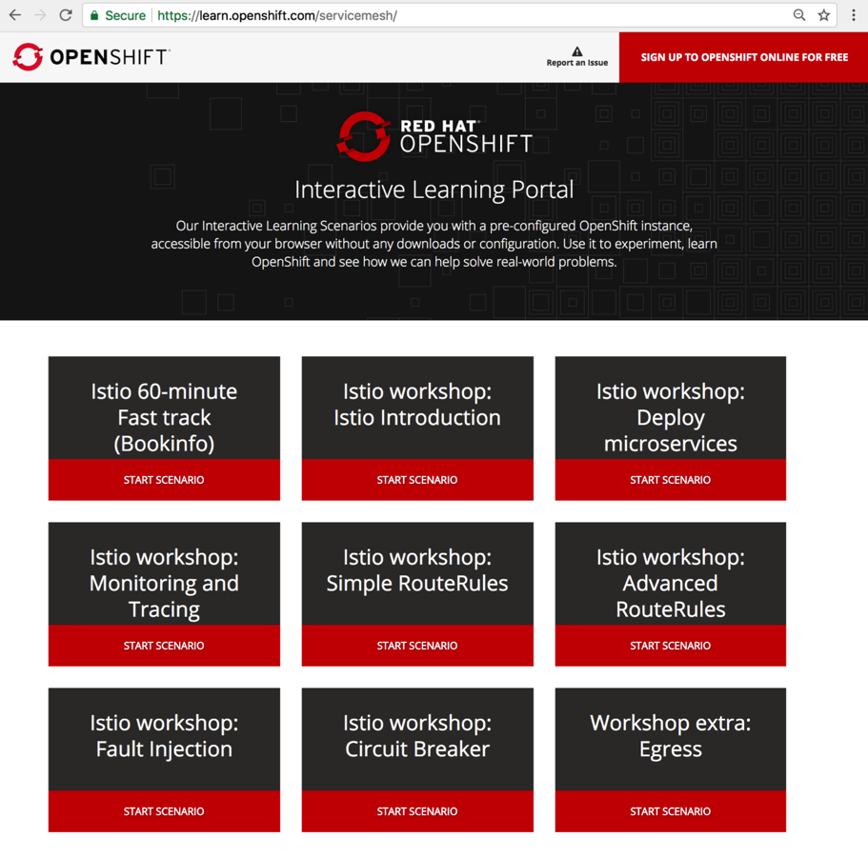
4. K8s - new ‘way’ of doing the things
1
https://learn.openshift.com/servicemesh/
https://www.katacoda.com/courses/kubernetes
http://kubernetesbyexample.com

Slide 13

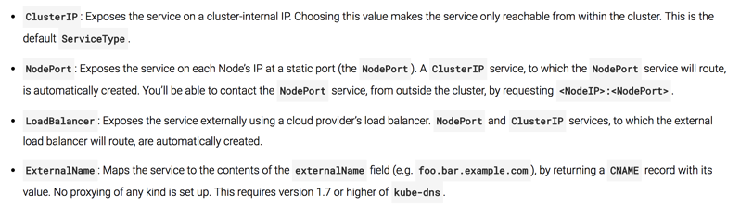
5. Delivering Distributed Apps: Pods & Services
Hosting (Amazon EC2, Google Kubernetes, Minikube, etc.)
Docker Registry
Kubernetes / Node₁
Edge Proxy
(Load Balancer)
Namespace_{A}
Port₁
LoadBalancer
Namespace_{A}
Namespace_{B}
nodePort₁
(hello-svc-lb)
Pod₁
http://<PublicIP>:<PublicPort>/hello
Pod₃
Docker₁
DNS
Port₂
NodePort
nodePort₂
(hello-svc-np)
5000
(hello-v1)
Port₃
ClusterIP
Pod₂
Lab 01: Delivering Apps
Node₂
(hello-svc-cip)
Namespace_{C}
Docker₂
http://<clusterIP>:<nodePort>/hello http://<NodeIP>:<nodePort>/hello http://<ServiceName>.<NameSpace>.svc.cluster.local:<port>/hello
Pod₄
2
5000
(hello-v2)
Docker₄
Services
1
Deployment
apiVersion: extensions/v1beta1
kind: Deployment
metadata:
name: hello-v1
namespace: hello
spec:
replicas: 1
template:
metadata:
labels:
app: hello
version: v1
spec:
serviceAccountName: helloworld-sa
containers:
- name: helloworld
image: istio/examples-helloworld-v1
imagePullPolicy: IfNotPresent
ports:
- containerPort: 5000
2
Kubernetes Services:
1
Deployment

Slide 14
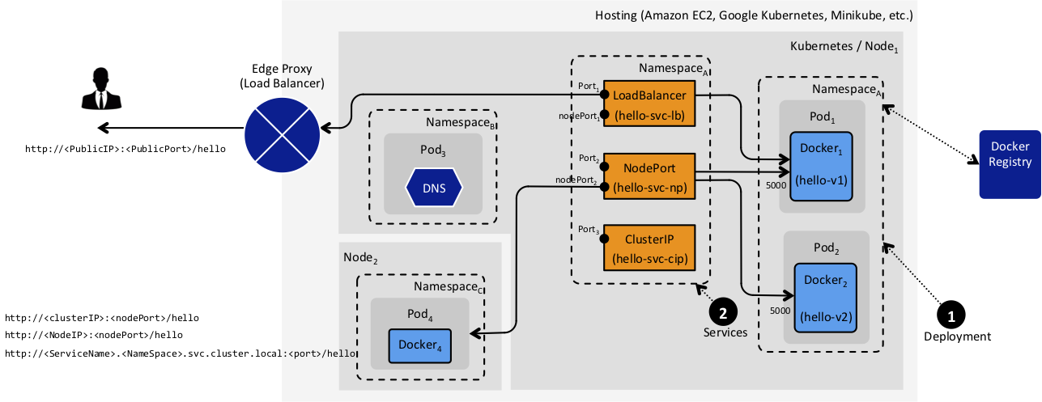
5. Delivering Distributed Apps: Issues
?
Any container can hit to other container running in different namespaces.
Too difficult to add security (MTLS, ACL, ..)
I’ve deployed my App (Pods & Services) in Kubernetes.
Now, Will the CI/CD scale?, Is it secure?
Too difficult to add more routes.
Sometimes the Edge Proxy should be managed / reconfigured everytime a new Route is added/changed.

Slide 15
6. Traffic Management w/ Ingress
Hosting (Amazon EC2, Google Kubernetes, Minikube, etc.)
Kubernetes
Node₁
Ingress Controller
Namespace_{A}
Edge Proxy
(Load Balancer)
Ingress Resource₁
Namespace_{A}
LoadBalancer
....
Port₁
LoadBalancer
Namespace_{A}
Ingress Resource_{n}
nodePort₁
(hello-svc-lb)
Pod₁
http://<PublicIP>:<PublicPort>/hello
Docker₁
Port₂
NodePort
1
nodePort₂
(hello-svc-np)
5000
(hello-v1)
2
Deployment
3
Service
Ingress
Port₃
ClusterIP
Pod₂
Lab 02: Ingress
(hello-svc-cip)
Docker₂
Namespace_{B}
Pod₃
DNS
Call NodePort or ClusterIP to Pods
5000
(hello-v2)
Ingress Controller
---
apiVersion: v1
kind: Service
metadata:
name: hello-svc-np
labels:
app: hello
namespace: hello
spec:
type: NodePort
ports:
- name: http
port: 5030
targetPort: 5000
selector:
app: hello
---
---
apiVersion: extensions/v1beta1
kind: Ingress
metadata:
name: hello-ing
annotations:
kubernetes.io/ingress.class: istio
spec:
rules:
- http:
paths:
- path: /hello
backend:
serviceName: hello-svc-np
servicePort: 5030
---
1
Deploy the choosen Ingress Controller in Pods and in a specified Namespace. Default HTTP Backend with custom error pages can be implemented.
Configure and integrate the deployed Ingress Controller with the EdgeProxy (Firewall, Root Proxy, Load Balancer, etc.). Generally, Ingress Controller is configured as Kubernetes Service LoadBalancer.
2
3
Finally, during CD time, every API/Microservice will be deployed with Ingress Resource definition (routing). TLS, MTLS or HTTP can be defined.
Notes:
What Ingress Controller can i use?
An Ingress Controller is a Proxy that works as Kubernetes Controller. They manage the traffic between EdgeProxy and Service Mesh (APIs/Microservices).
A Proxy deployed in Pods doesn’t mean that you have an Ingress Controller.
There are several Ingress Controller implementations, they can manage different kind of traffic (HTTP, HTTPS, gRCP, Websockets, TCP, UDP, …) and different functionalities (VIP, Virtual Hosts, Paths, …); then the chosen Ingress Controller depends on the kind of traffic that your API/Microservices manage and how they were implemented (Ports exposed, Paths used, Headers expected, etc.)
Examples:
Heption Contour (based on Envoy Proxy)
Istio Ingress Controller (based on Envoy Proxy)
Linkerd Ingress Controller (based on Linkerd Gateway)
HAProxy Controller (based on HAProxy)
NGINX Controller (based on NGINX), etc.

Slide 16
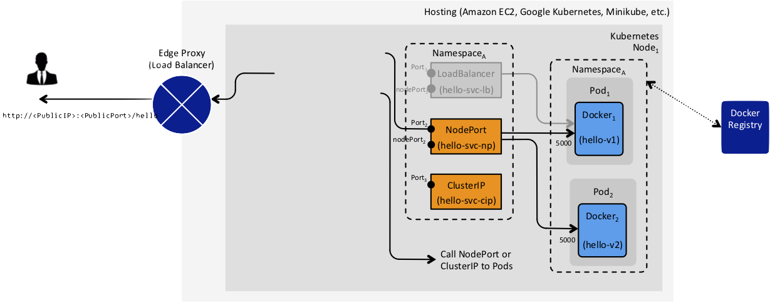
6. Traffic Management w/ Ingress: Issues
Ingress Controller
Namespace_{A}
Ingress Resource₁
LoadBalancer
....
Ingress Resource_{n}
1
2
Deployment
3
Service
Ingress
?
It isn’t secure because the Pods still are accesibles. Any other Pod (container) can call this.
I’ve implemented the Ingress Controller in Service Mesh.
Now, Is that Secure?
It isn’t secure because that doesn’t have:
Separation of Duties
Principle of Last Privilege
Identity-based Security
End-to-end security: the App Container still is available and nobody can stop to make call to that Container.
Container Patterns (sidecar container as last-mile protection)
Registry, Auditability and Traceability. It means that all App Containers (APIs and Microservices) living in the Service Mesh should be Identified and Traceable.
Notes:
What Ingress Controller can i use?
An Ingress Controller is a Proxy that works as Kubernetes Controller. They manage the traffic between EdgeProxy and Service Mesh (APIs/Microservices).
A Proxy deployed in Pods doesn’t mean that you have an Ingress Controller.
There are several Ingress Controller implementations, they can manage different kind of traffic (HTTP, HTTPS, gRCP, Websockets, TCP, UDP, …) and different functionalities (VIP, Virtual Hosts, Paths, …); then the chosen Ingress Controller depends on the kind of traffic that your API/Microservices manage and how they were implemented (Ports exposed, Paths used, Headers expected, etc.)
Examples:
Heption Contour (based on Envoy Proxy)
Istio Ingress Controller (based on Envoy Proxy)
Linkerd Ingress Controller (based on Linkerd Gateway)
HAProxy Controller (based on HAProxy)
NGINX Controller (based on NGINX), etc.

Slide 17
7. Traffic Management w/ Ingress + Sidecar
Hosting (Amazon EC2, Google Kubernetes, Minikube, etc.)
Kubernetes Node₁
Namespace_{secure}
Namespace_{A}
Edge Proxy
(Load Balancer)
Ingress Controller
Ingress Resource₁
Namespace_{A}
LoadBalancer
Services
....
LoadBalancer
Pod₁
Ingress Resource_{n}
(hello-svc-lb)
Docker₁
http://<PublicIP>:<PublicPort>/hello
Port₂
NodePort
Sidecar_{x}
1
nodePort₂
(hello-svc-np)
5000
(hello-v1)
Deployment
ClusterIP
7
2
3
(hello-svc-cip)
Pod₂
Lab 03: Ingress and Sidecar
TLS Pass-through and Termination config.
Service
Ingress
Docker₂
AuthN + AuthZ
Service
Sidecar_{y}
5000
(hello-v2)
Registry
Call NodePort or ClusterIP to Pods
4
Container Patterns
6
Registry and Discovery
5
“Identity-based Security” strategy
Ingress Controller
Traffic Management (L7 Firewall)
1
Deploy the choosen Ingress Controller in Pods and in a specified Namespace. Default HTTP Backend with custom error pages can be implemented.
Inject Sidecar in the same Pod where the App Container is living. Sidecar bootstraps security config. to reject traffic from untrusted source.
4
Configure and integrate the deployed Ingress Controller with the EdgeProxy (Firewall, Root Proxy, Load Balancer, etc.). Generally, Ingress Controller is configured as Kubernetes Service LoadBalancer.
+
5
The “Single Source of Truth“ does validate and authorize the incomming traffic.
2
6
It provides a fine-grained control over all App Containers running in the Service Mesh.
3
Finally, during CD time, every API/Microservice will be deployed with Ingress Resource definition (routing). TLS, MTLS or HTTP can be defined.
The TLS termination should be configured properly in order to be managed dynamically for the Ingress Controller. It means to manage the lifecycle of the TLS Certs.
7

Slide 18
8. Traffic Management w/ Ingress + Sidecar + Network Policy
Hosting (Amazon EC2, Google Kubernetes, Minikube, etc.)
Kubernetes Node₁
Namespace_{secure}
Namespace_{A}
Edge Proxy
(Load Balancer)
Ingress Controller
Ingress Resource₁
Namespace_{A}
LoadBalancer
Services
....
LoadBalancer
Pod₁
Ingress Resource_{n}
(hello-svc-lb)
Docker₁
http://<PublicIP>:<PublicPort>/hello
Port₂
NodePort
Sidecar_{x}
1
nodePort₂
(hello-svc-np)
5000
(hello-v1)
Deployment
ClusterIP
7
2
3
(hello-svc-cip)
Pod₂
Lab 04: Ingress, Sidecar and Network Policy
TLS Pass-through and Termination config.
Service
Ingress
Docker₂
AuthN + AuthZ
Service
Sidecar_{y}
5000
(hello-v2)
Registry
SDN / Network Provider
“Identity-based Security” strategy
5
Call NodePort or ClusterIP to Pods
4
Container Patterns
6
Registry and Discovery
8
Network Policy
Ingress Controller
Secure Traffic Management (L7 Firewall)
Secure Traffic Management (L3/L4 Firewall)
1
Deploy the choosen Ingress Controller in Pods and in a specified Namespace. Default HTTP Backend with custom error pages can be implemented.
Inject Sidecar in the same Pod where the App Container is living. Sidecar bootstraps security config. to reject traffic from untrusted source.
The TLS termination should be configured properly in order to be managed dynamically for the Ingress Controller. It means to manage the lifecycle of the TLS Certs.
4
7
Configure and integrate the deployed Ingress Controller with the EdgeProxy (Firewall, Root Proxy, Load Balancer, etc.). Generally, Ingress Controller is configured as Kubernetes Service LoadBalancer.
+
5
The “Single Source of Truth“ does validate and authorize the incomming traffic.
+
2
The Sidecar assures End-to-end TLS communication (between API/Microservice and Edge Proxy through Ingress Controller). Additionally, Sidecar manages the TLS Certificate Lifecycle (revocation, renewal, validations, etc.)
6
It provides a fine-grained control over all App Containers running in the Service Mesh.
4
3
Finally, during CD time, every API/Microservice will be deployed with Ingress Resource definition (routing). TLS, MTLS or HTTP can be defined.
The TLS termination should be configured properly in order to be managed dynamically for the Ingress Controller. It means to manage the lifecycle of the TLS Certs.
7

Slide 19
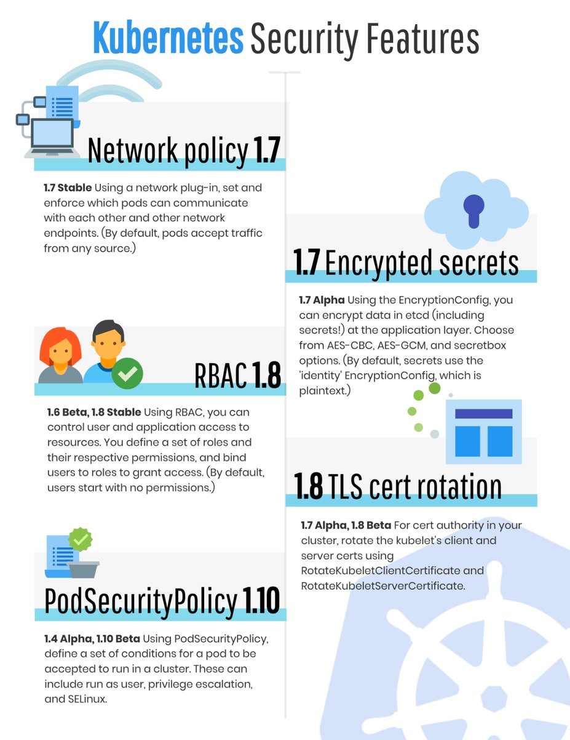
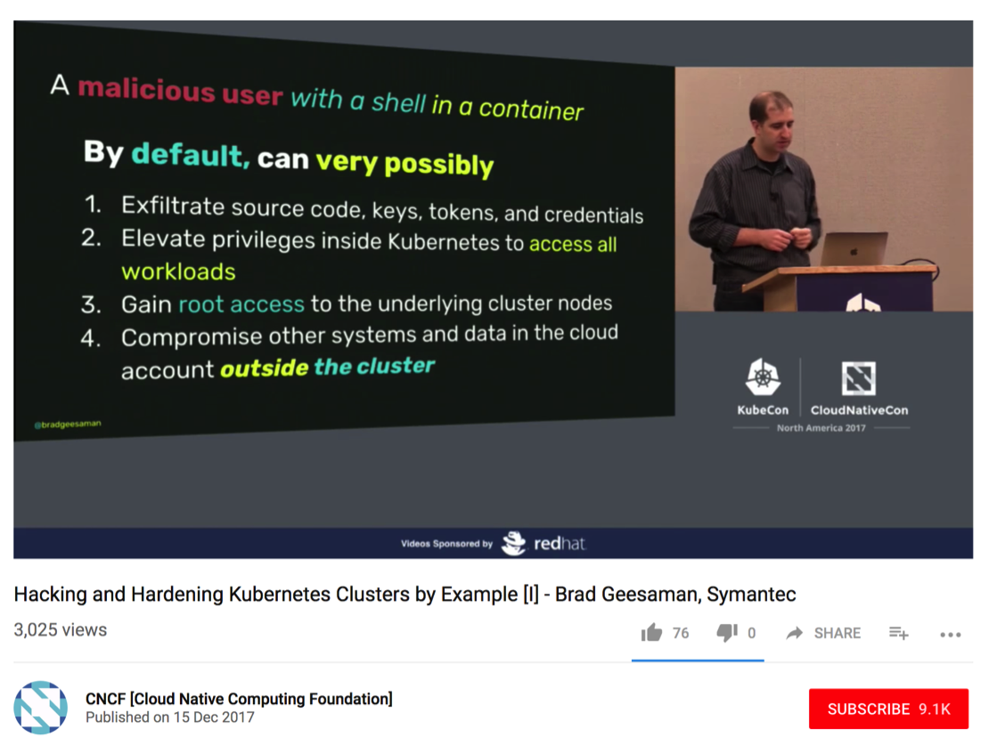
9. Security Assessment – New threat vectors
Lab 05: Security Assessment

Slide 20
10. Service Mesh: Reference Architecture

Slide 21
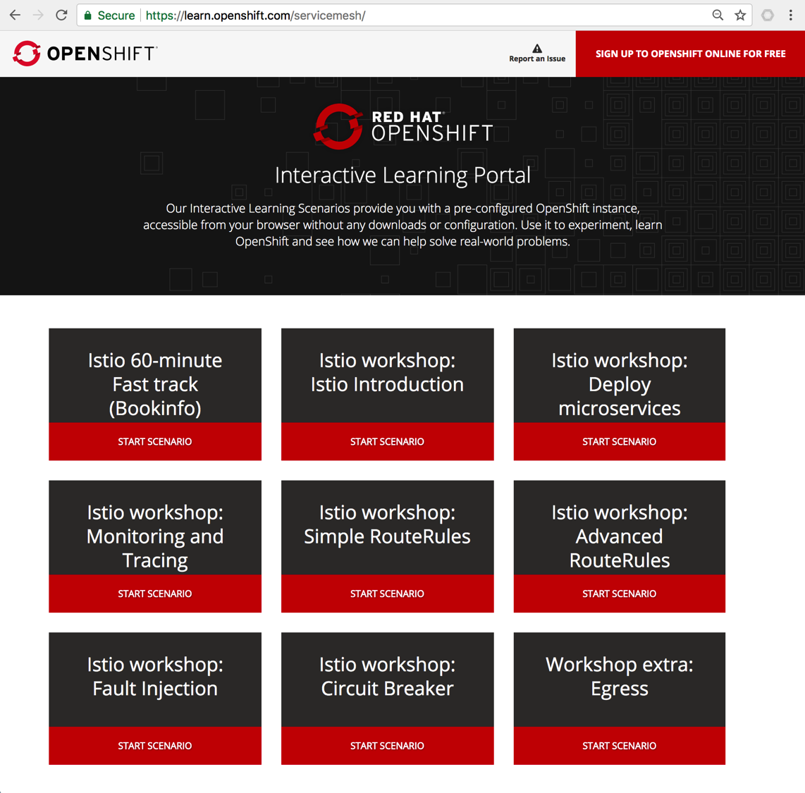
10. Service Mesh: Learning Istio
https://learn.openshift.com/servicemesh

Slide 22


10. Service Mesh: Istio Framework
Hosting
Edge Proxy
(Load Balancer)
Kubernetes
Node₁
Services
ClusterIP₁
Pod₁
Service Mesh Control Plane
Istio Ingress
Docker₁
ClusterIP₂
Sidecar₁
Istio CA
ClusterIP₃
Istio Pilot
Istio Mixer
Kubernetes
Node₂
Istio Auth
Pod₂
Docker₂
Lab 06: Weaving Service Mesh

Slide 23
11. Routing and Chaining APIs (PoC)
Hosting
Edge Proxy
(Load Balancer)
Kubernetes
Node₁
Services
Pod₁
Pod₂
Docker₁
5
Docker₂
ClusterIP₂
(5001)
(5050)
(test1-svc)
(80)
4
(gis-test-sidecar)
(gis-test-api)
1
ClusterIP₁
(6000)
2
(test1-ambassador- svc)
3
Pod₃
Docker₃
Kubernetes API Server
(gis-validator)
Lab 07: Routing and Chaining APIs

